Slide 1
Systems and Methods for Live Conversation Using Hearing Devices
US20210392427A1
Notes:
https://patents.google.com/patent/US20210392427A1

Slide 2
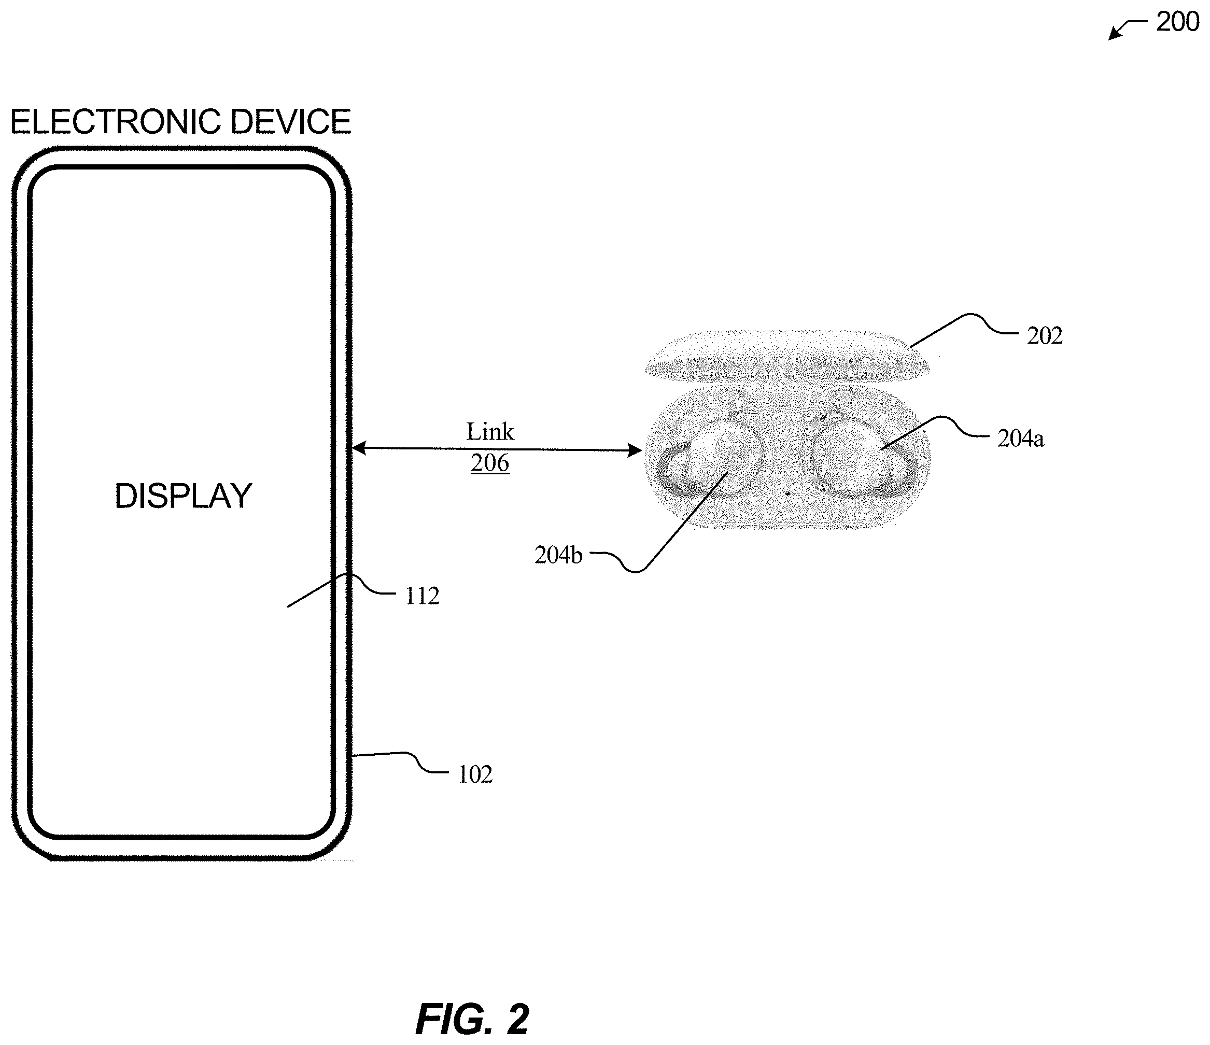
Notes:
FIG. 2 illustrates example wireless connection environment 200 including an electronic device 102 connected to an example hearing device 202 via link 206

Slide 3
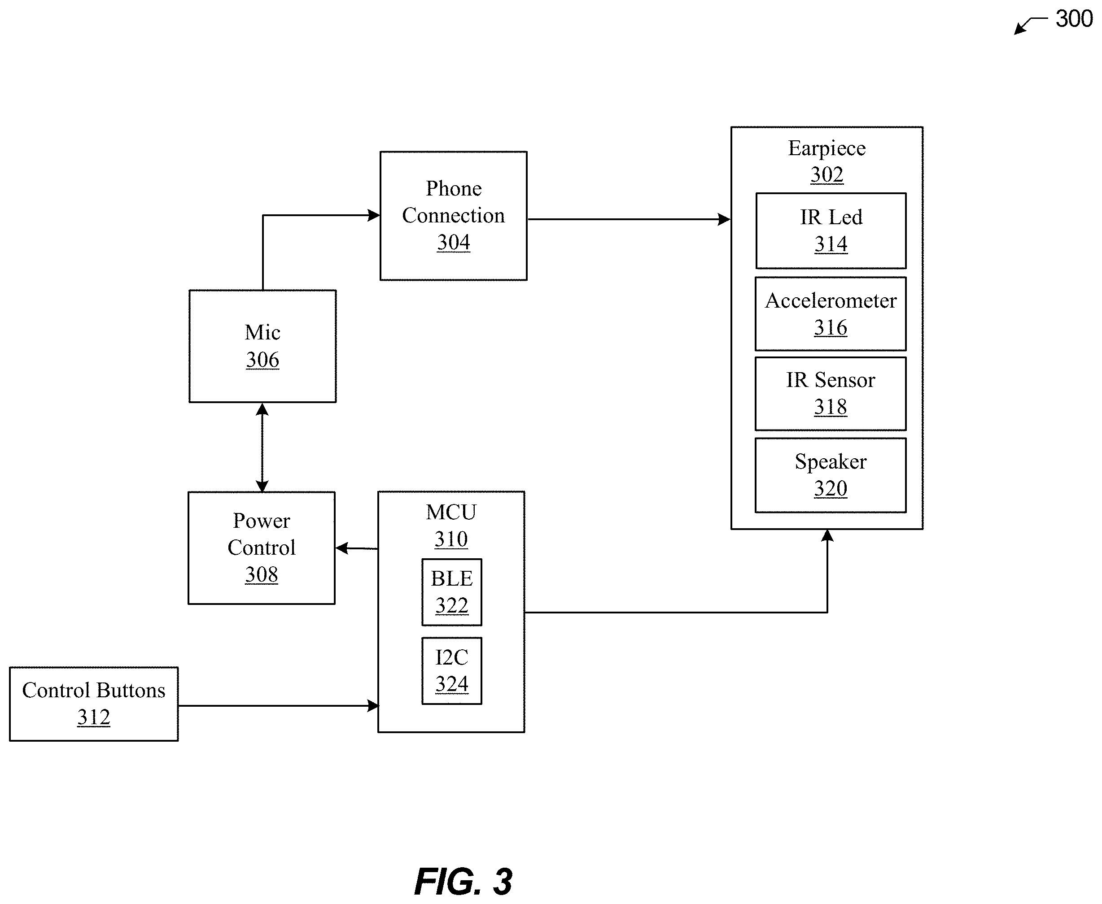
Notes:
Live Conversation Using Hearing Devices[0028]In particular embodiments, the disclose technology includes a system for live audio communication. The live audio communication may be enabled between two wireless hearing devices. As an example and not by way of limitation, the system may enable a direct live audio communication between two Bluetooth headsets.
The control device may then establish a live audio communication between the two different Bluetooth headsets by redirecting live audio communication between a first Bluetooth headset and the control device to a second Bluetooth headset.

Slide 4
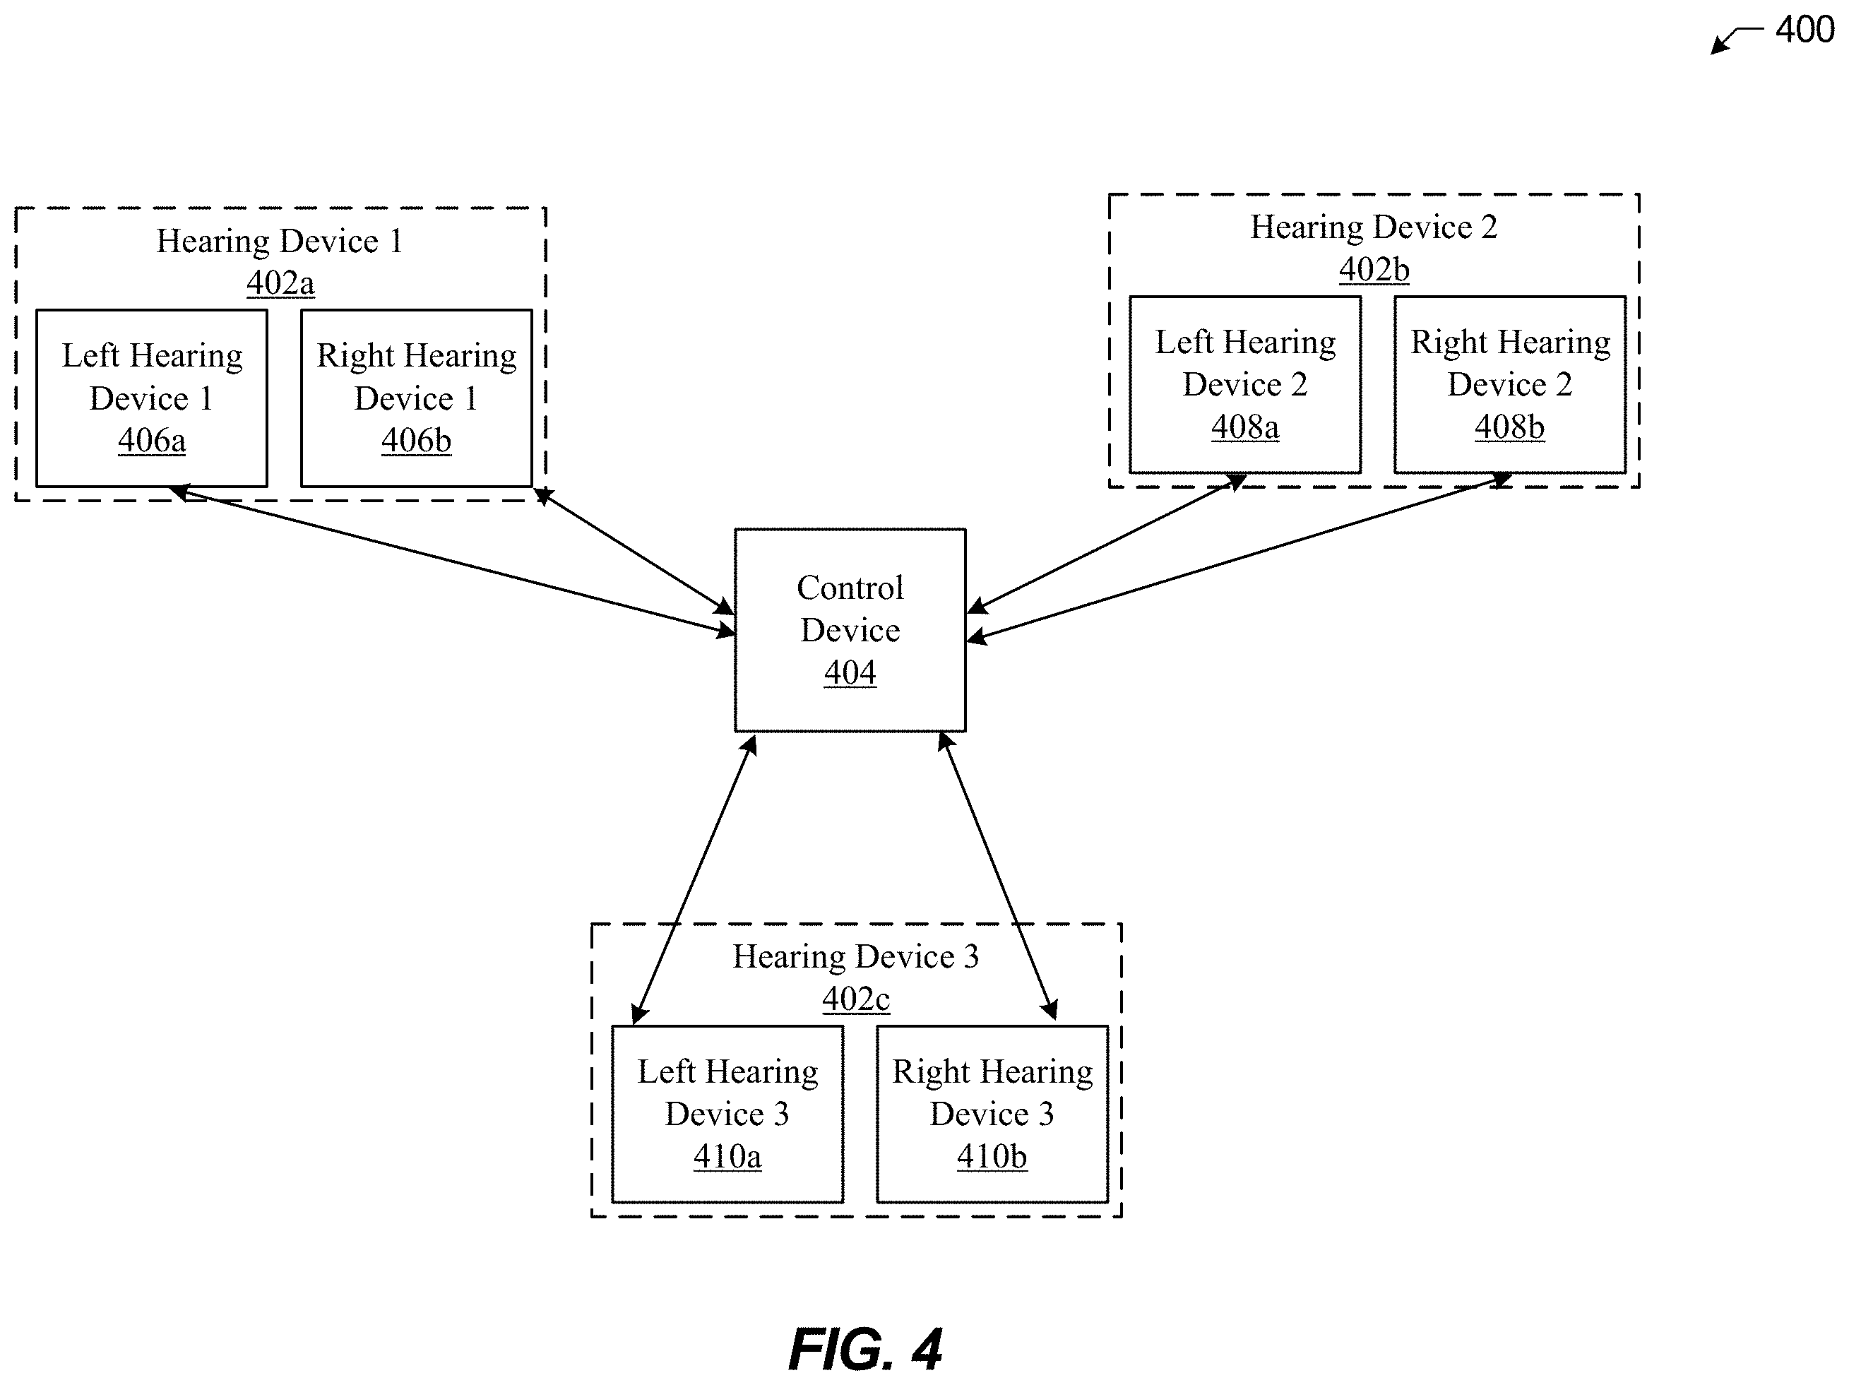

Slide 5
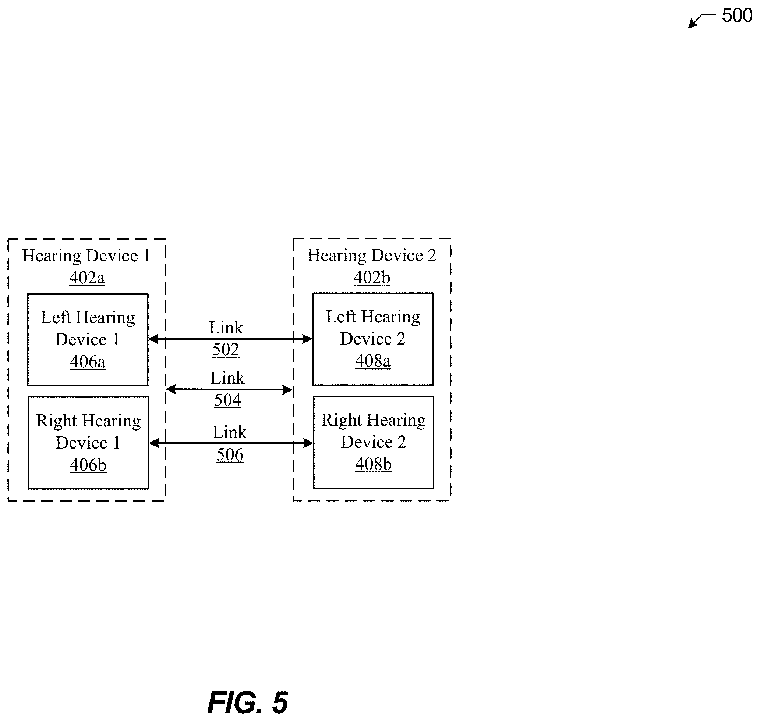

Slide 6
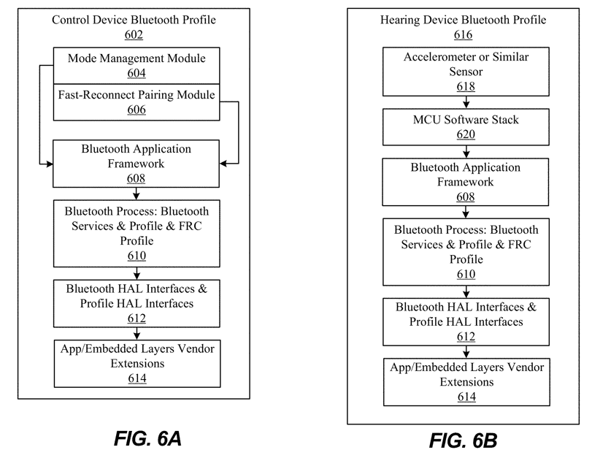
Notes:
Bluetooth process 610, Bluetooth hardware abstraction layer (HAL) interfaces & Profile HAL interfaces

Slide 7
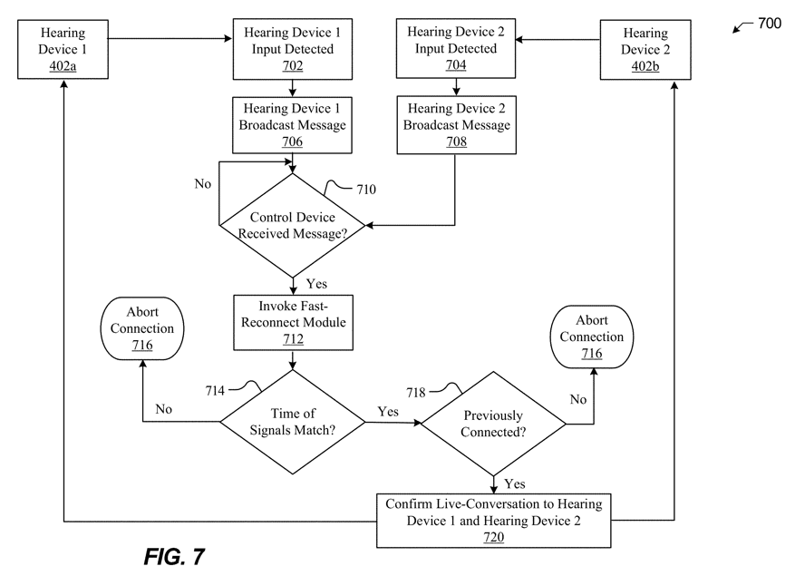
Notes:
detecting an input at step 702 and detecting an input at step 704, respectively. Step 702 and step 704 may occur simultaneously or at least within a threshold time period
The broadcast message may be a request to redirect live audio communication between the hearing device 1 402 a and a control device to a hearing device 2 402 b. The broadcast message may be a request for the hearing device 1 402 a to directly communicate with a hearing device 2 402 b.
At step 710, a control device may determine whether any broadcast messages are received. In particular embodiments, the control device may periodically check to see if any broadcast messages are received from one or more hearing devices. If the control device does not receive a message, the process 700 may loop back to periodically check to see if a message is received
At step 712, a control device may invoke a fast-reconnect module. The fast-reconnect module may perform an audio redirection function where the control device determines whether to redirect a live audio communication between the control device and a hearing device to another hearing device
At step 714, the control device may determine whether a time of signals match. As an example and not by way of limitation, the control device may determine whether the time an input is received at a hearing device 2 402 b is within a threshold time period of when an input is received at a hearing device 1 402 a.
step 718 to determine whether the hearing device 1 402 a and the hearing device 2 402 b have been previously connected. If the hearing devices 402 have not been previously connected, then the process 700 may continue to step 716 where the connection is aborted. If the hearing devices 402 have been previously connected, then the process 700 may continue to step 720

Slide 8
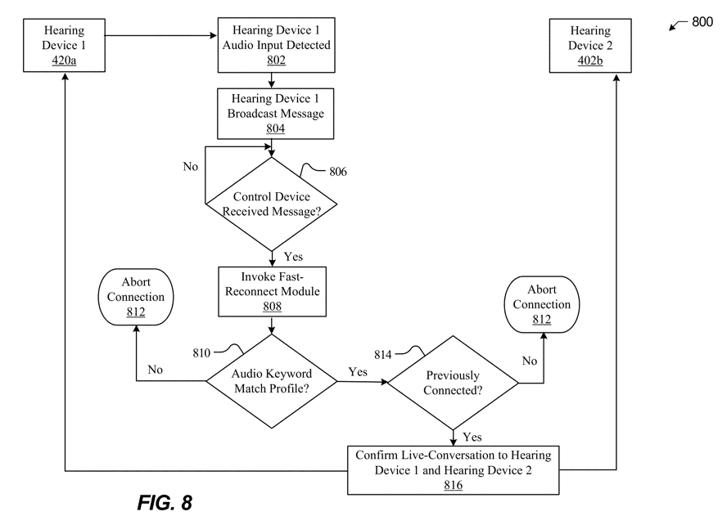
Notes:
hearing device 1 402 a receiving an audio input at step 802 In particular embodiments, the hearing device 1 402 a may receive an audio input comprising a text keyword. The hearing device 1 402 a may be configured to parse an audio input to detect a text keyword.

Slide 9
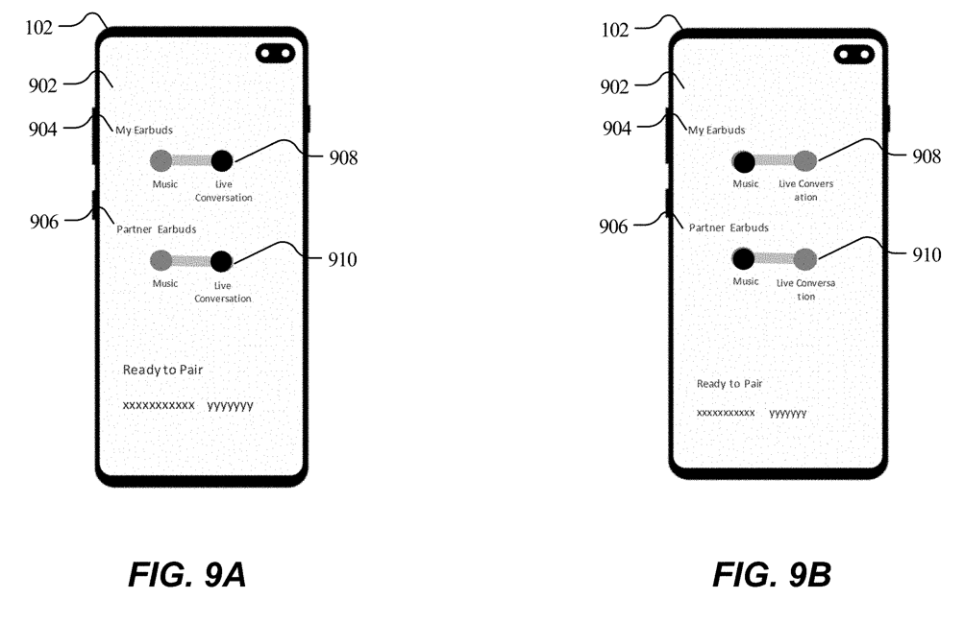

Slide 10
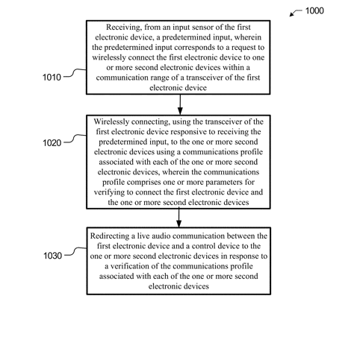
Notes:
FIG. 10 illustrates is a flow diagram of a method for connecting hearing devices

Slide 11
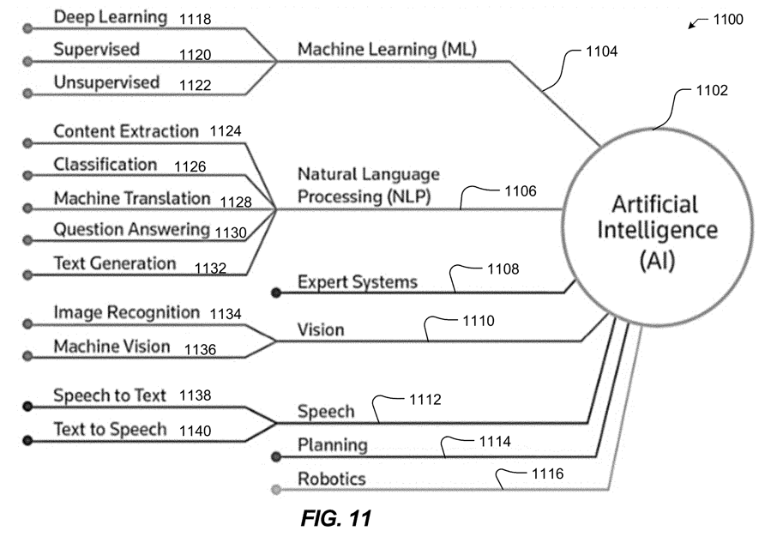

Slide 12
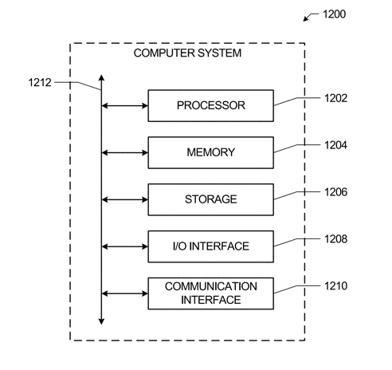

Slide 15
Thank you
Notes:
https://patents.google.com/patent/US20210392427A1

